Slide 1


Sprint 1 Presentation
Trey Mullis, Anthony DeFazio, Ty Hicks, Aayush Sapkota

Slide 2

Company Background
Community of Hope was founded in 2004
In 2006 they opened their food pantry for the first time

Slide 3
Current Environment
Currently, Community of Hope provides food for approximately 200 people per month
Scheduling is determined by which volunteers show up first
Inventory is determined by eyeballing items and seeing what they are low or full on

Slide 4
Why have we chosen this project?
Give us a challenge with developing a system for a non-profit organization
Explore all the possibilities with creation and hopefully implementing into something they could use in their day-to-day work
Real life experience and project teamwork with a client

Slide 5

Problems Observed with current system?
Currently BPA, they have no system currently being used
We plan to be the first to implement them a system that could be very beneficial to them

Slide 6
Proposed Systems Objectives/ Constraints
Objectives | Constraints
Automate the scheduling process for inventory management to increase efficiency and reduce manual errors. | Adherence to industry regulations and standards for inventory management.
Provide real-time inventory visibility and location tracking for improved supply chain management. | Data privacy and security of sensitive inventory information.
Enhance collaboration between different departments and stakeholders involved in inventory management. | Financial and resource constraints such as budget and manpower availability.

Slide 7
Expected Benefits...
System to track their inventory and easily see which products they do and don't have
Have a scheduling process that could be used to have volunteers sign up and know when their shift is

Slide 8
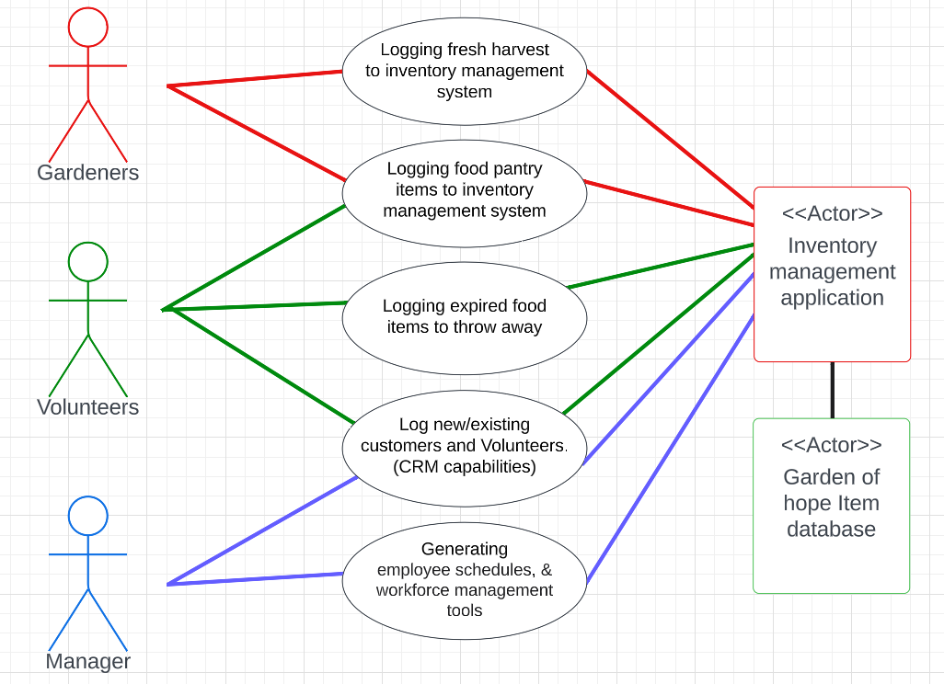
Use case diagram

Slide 9
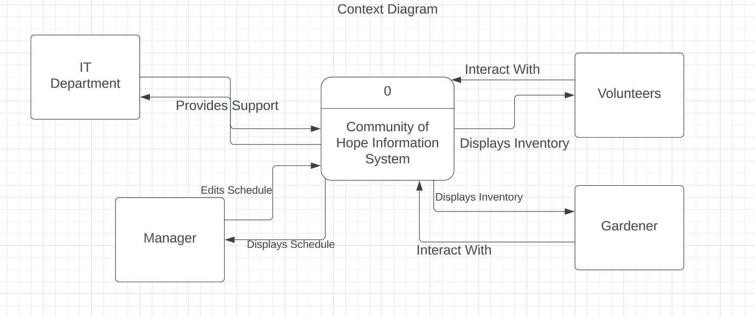
Context diagram

Slide 10
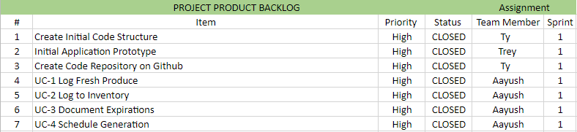
Initial Product Backlog

Slide 11
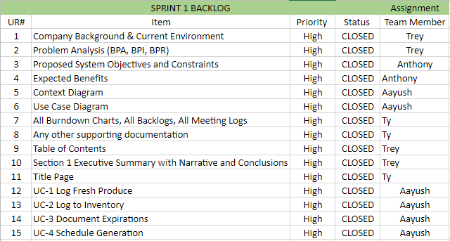
Sprint 1 Project Backlog

Slide 12
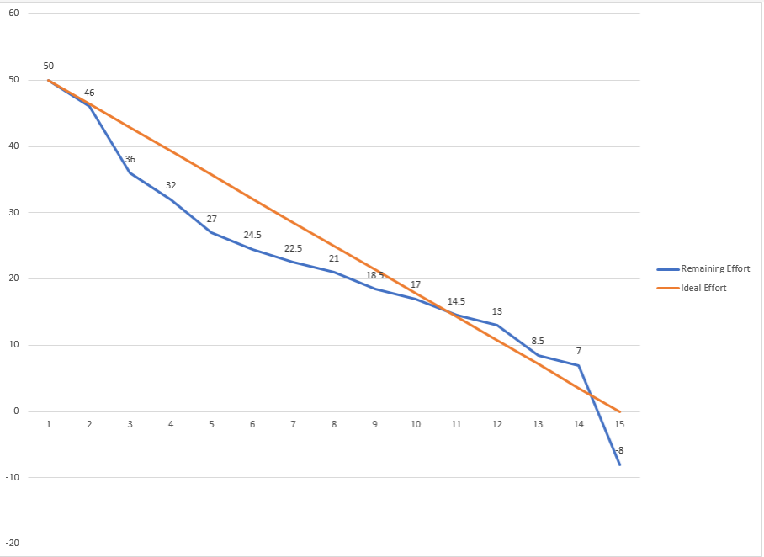
Sprint 1 Burndown Chart

Slide 13
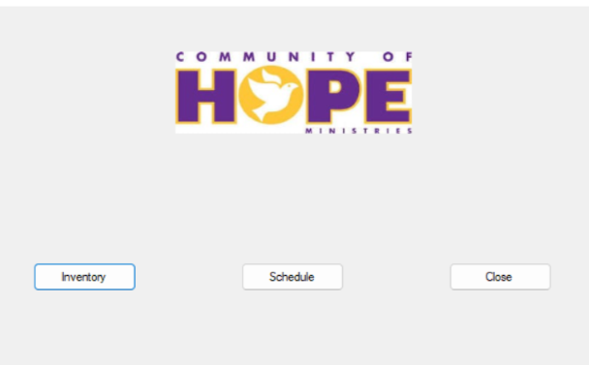
PSPI

